Slide 1
Bangla Search Suggestion

Slide 2
Bangla Search Suggestion
Search Suggestion, Query Auto Completion and Auto Correction missing in the only Bangla Search Engine, Pipilika.
Relatively new even in Giant search engines like Google and Bing.

Slide 3
Bangla Search Suggestion
Whole System is segmented into three parts.
Query Auto Correction
Query Auto Completion
Query Suggestion
How the System Functions
Query Log
Auto Completion
Auto Correction
Query Suggestion

Slide 4
Query Auto Correction
Problems:
No Available Bangla Dictionary
Large Dictionary, Large Time Complexity
Suggesting Correct Word in place of a Wrong Word

Slide 5
Query Auto Correction
BK-Tree or Burkhard-Keller Tree
Uses only words as nodes
Levenshtein Distance
Uses triangle inequality rule to search it’s node
Max Distance: n, Word Distance: d, searches node with Distace (d-n) to (d+n)

Slide 6
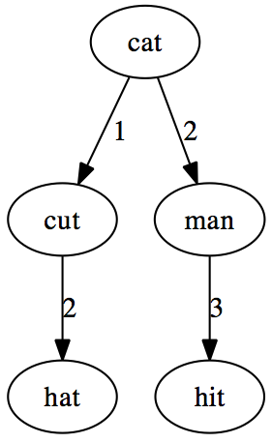
Query Auto Correction
Root word is “cat”
Makes each node starting from the root, comparing their Levenshtein Distance

Slide 7
Query Auto Correction
N-Gram Model
Probabilistic Language Model for predicting the next item in a sequence.
Used in Auto Correction to guess the correct word more accurately.

Slide 8
Future Plans
Using Levenshtein Automata to determine Distance.
N-Gram Model in Reverse Order.

